Slide 1
Internet Protocols & Networked computing

Slide 2
The OSI Model
OSI “ Open Systems Interconnection".
OSI model was first introduced in 1984 by the International Organization for Standardization (ISO).
Outlines WHAT needs to be done to send data from one computer to another.
Not HOW it should be done.
Protocols stacks handle how data is prepared for transmittal (to be transmitted)
In the OSI model, The specification needed
are contained in 7 different layers that interact with each other.

Slide 3
What is “THE MODEL?”
Commonly referred to as the OSI reference model.
The OSI model
is a theoretical blueprint that helps us understand how data gets from one user’s computer to another.
It is also a model that helps develop standards so that all of our hardware and software talks nicely to each other.
It aids standardization of networking technologies by providing an organized structure for hardware and software developers to follow, to insure there products are compatible with current and future technologies.

Slide 4
Layers
Physical Layer
Describes physical aspects of network: cards, wires, etc
Specifies interconnect topologies and devices
Data-Link
Works with Network Layer to translate logical addresses (IP) into hardware addresses (MAC) for transmission
Defines a single link protocol for transfer between two nodes
Network Layer
Defines a standard method for operating between nodes
Address scheme is defined (IP)
Accounts for varying topologies

Slide 5
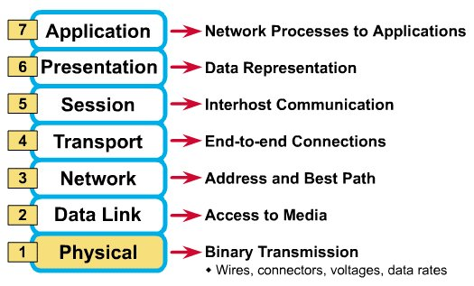
What Each Layer Does
²

Slide 6
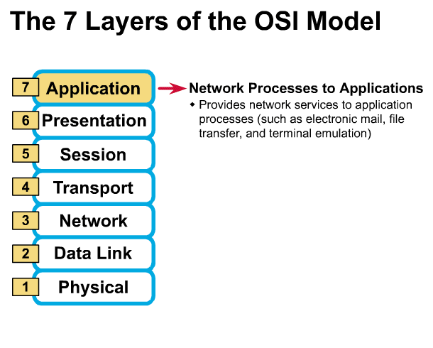
Gives end-user applications access to network resources
Where is it on my computer?
Workstation or Server Service in MS Windows
³

Slide 7
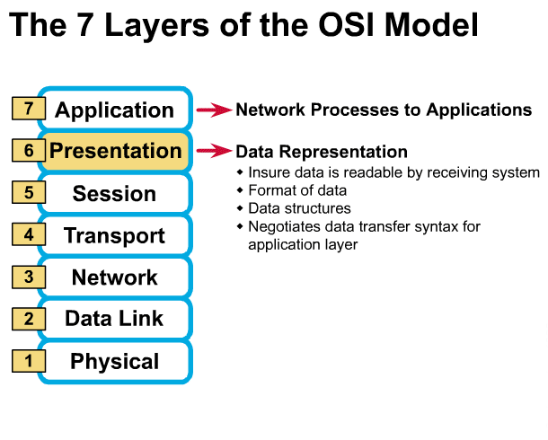
Presentation Layer
³

Slide 8
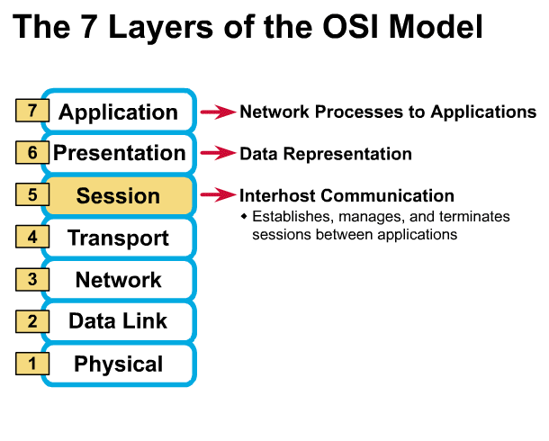
Session Layer
Allows applications to maintain an ongoing session
Where is it on my computer?
Workstation and Server Service (MS)
Windows Client for NetWare (NetWare)
³

Slide 9
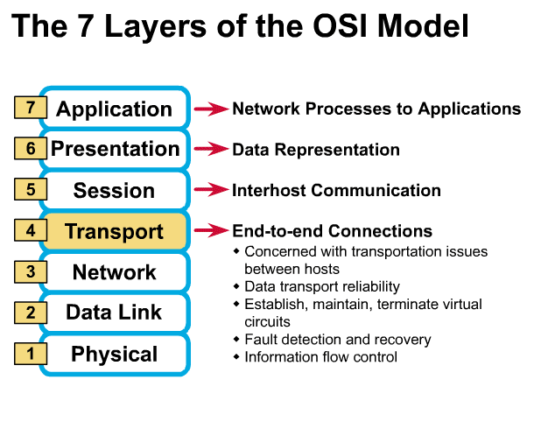
Transport Layer
Provides reliable data delivery
It’s the TCP in TCP/IP
Receives info from upper layers and segments it into packets
Can provide error detection and correction
³

Slide 10
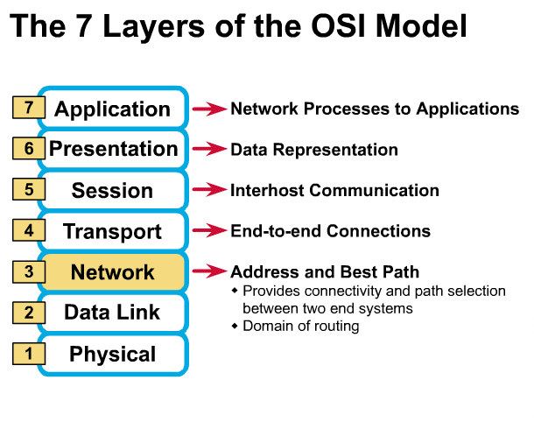
Network Layer
Provides network-wide addressing and a mechanism to move packets between networks (routing)
Responsibilities:
Network addressing
Routing
Example:
IP from TCP/IP
³

Slide 11
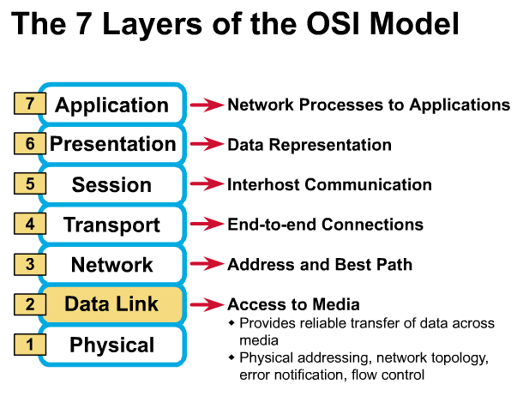
Data Link Layer
Places data and retrieves it from the physical layer and provides error detection capabilities
³

Slide 12
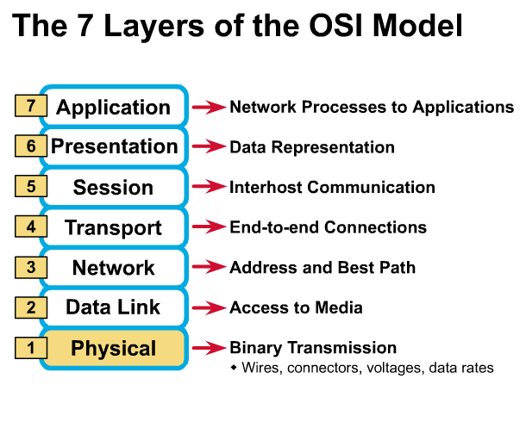
Physical Layer
Determines the specs for all physical components
Cabling
Interconnect methods (topology / devices)
Data encoding (bits to waves)
Electrical properties
Examples:
Ethernet (IEEE 802.3)
Token Ring (IEEE 802.5)
Wireless (IEEE 802.11b)
³

Slide 13
Physical Layer
What are the Physical Layer components on my computer?
NIC
Network Interface Card
Has a unique 12 character Hexadecimal number permanently burned into it at the manufacturer.
The number is the MAC Address/Physical address of a computer
Cabling
Twister Pair
Fiber Optic
Coax Cable

Slide 14
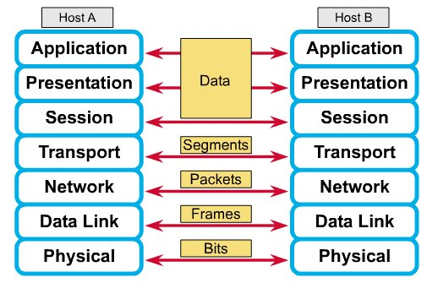
How Does It All Work Together
Each layer contains a Protocol Data Unit (PDU)
PDU’s are used for peer-to-peer contact between corresponding layers.
Data is handled by the top three layers, then Segmented by the Transport layer.
The Network layer places it into packets and the Data Link frames the packets for transmission.
Physical layer converts it to bits and sends it out over the media.
The receiving computer reverses the process using the information contained in the PDU.
²

Slide 15
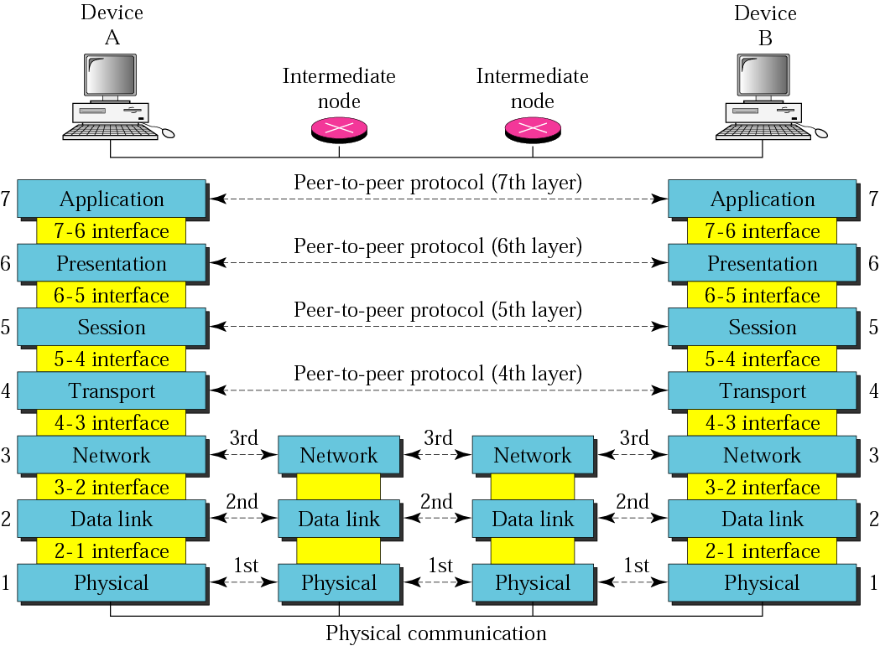
Figure 2.2 OSI layers

Slide 16
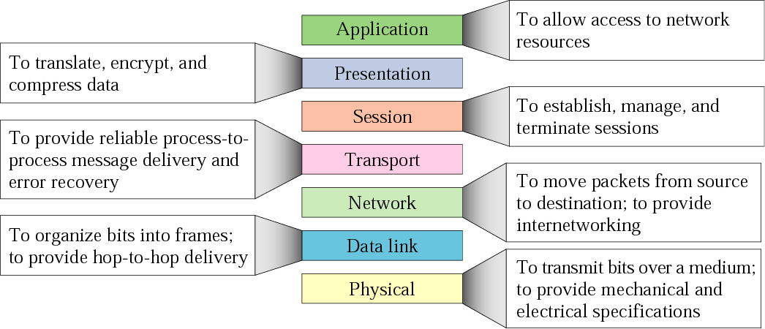
Summary of layers

Slide 17
Protocols at the application layer
HTTP:
browser and web server communicatin
FTP :
file transfer protocol
TELNET:
remote login protocol
POP3: Retrieve email
POP3 is designed to delete mail on the server as soon as the user has downloaded it
IMAP (Internet Message Access Protocol )
Retrieve emails,
retaining e-mail on the server and for organizing it in folders on the serve

Slide 18
Protocols at the transport layer
Transmission control protocol (TCP),
Connection oriented
Connection established before sending data
Reliable
user datagram protocol (UDP)
Connectionless
Sending data without establishing connection
Fast but unreliable

Slide 19
Protocol at the network layer
IP
Path selection ,
routing and addressing
ICMP (Internet Control Message Protocol )
sends error messages relying on IP
a requested service is not available
a host or router could not be reached

Slide 20
How the OSI and TCP/IP Models Relate in a Networking Environment

Slide 21
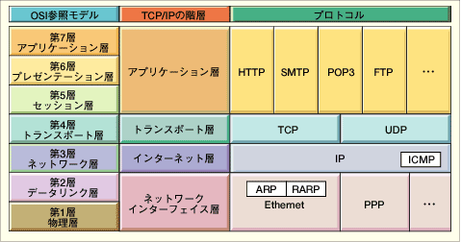
Comparing TCP/IP with OSI
OSI Model
TCP/IP Hierarchy
Protocols
7th
Application Layer
6th
Presentation Layer
Application Layer
5th
Session Layer
4th
Transport Layer
Transport Layer
3rd
Network Layer
Network Layer
2nd
Link Layer
Link Layer
1st
Physical Layer
Link Layer : includes device driver and network interface card
Network Layer : handles the movement of packets, i.e. Routing
Transport Layer : provides a reliable flow of data between two hosts
Application Layer : handles the details of the particular application

Slide 22
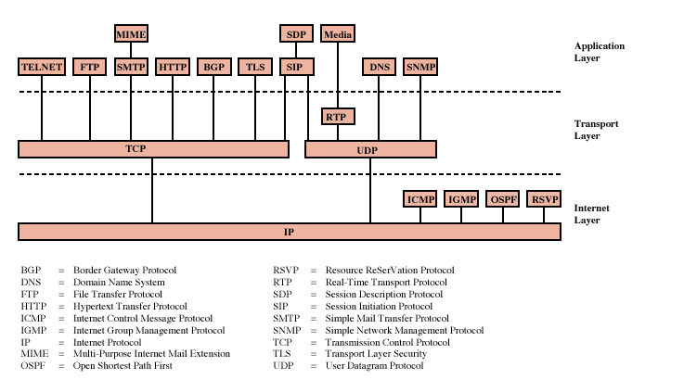
Protocols of TCP/IP Protocol Suite

Slide 23
SMTP
SMTP stands for Simple Mail Transfer Protocol.
SMTP is a set of communication guidelines that allow software to transmit an electronic mail over the internet is called Simple Mail Transfer Protocol.
It is a program used for sending messages to other computer users based on e-mail addresses.
It provides a mail exchange between users on the same or different computers, and it also supports:
It can send a single message to one or more recipients.
Sending message can include text, voice, video or graphics.
It can also send the messages on networks outside the internet.
The main purpose of SMTP is used to set up communication rules between servers. The servers have a way of identifying themselves and announcing what kind of communication they are trying to perform. They also have a way of handling the errors such as incorrect email address. For example, if the recipient address is wrong, then receiving server reply with an error message of some kind.

Slide 24
Protocols
Ethernet is a way of connecting computers together in a local area network or LAN.
It has been the most widely used method of linking computers together in LANs since the 1990s. The basic idea of its design is that multiple computers have access to it and can send data at any time.
The NDIS is a library of functions often referred to as a "wrapper" that hides the underlying complexity of the NIC hardware and serves as a standard interface for level 3 network protocol drivers and hardware level MAC drivers.

Slide 25
Protocols
NFS, or Network File System, was designed in 1984 by Sun Microsystems.
This distributed file system protocol allows a user on a client computer to access files over a network in the same way they would access a local storage file.
Because it is an open standard, anyone can implement the protocol.
The Open Data-Link Interface (ODI), developed by Apple and Novell, serves the same function as Microsoft and 3COM's Network Driver Interface Specification (NDIS).
Originally, ODI was written for NetWare and Macintosh environments.
Like NDIS, ODI provides rules that establish a vendor-neutral interface between the protocol stack and the adapter driver. It resides in Layer 2, the Data Link layer, of the OSI model. This interface also enables one or more network drivers to support one or more protocol stacks

Slide 26
What is HTTP?
An HTTP stands for Hypertext Transfer Protocol.
The HTTP protocol provides communication between different communication systems.
When the user makes an HTTP request on the browser, then the webserver sends the requested data to the user in the form of web pages.
In short, we can say that the HTTP protocol allows us to transfer the data from the server to the client.
An HTTP is an application layer protocol that comes above the TCP layer. It has provided some standard rules to the web browsers and servers, which they can use to communicate with each other.
An HTTP is a stateless protocol as each transaction is executed separately without having any knowledge of the previous transactions, which means that once the transaction is completed between the web browser and the server, the connection gets lost.

Slide 27
What is HTTPS?
The full form of HTTPS is Hypertext Transfer Protocol Secure. The HTTP protocol does not provide the security of the data, while HTTPs ensures the security of the data.
Therefore, we can say that HTTPS is a secure version of the HTTP protocol. This protocol allows transferring the data in an encrypted form.
The use of HTTPS protocol is mainly required where we need to enter the bank account details. The HTTPS protocol is mainly used where we require to enter the login credentials.

Slide 28
FTP
FTP stands for File transfer protocol.
FTP is a standard internet protocol provided by TCP/IP used for transmitting the files from one host to another.
It is mainly used for transferring the web page files from their creator to the computer that acts as a server for other computers on the internet.
It is also used for downloading the files to computer from other servers.

Slide 29
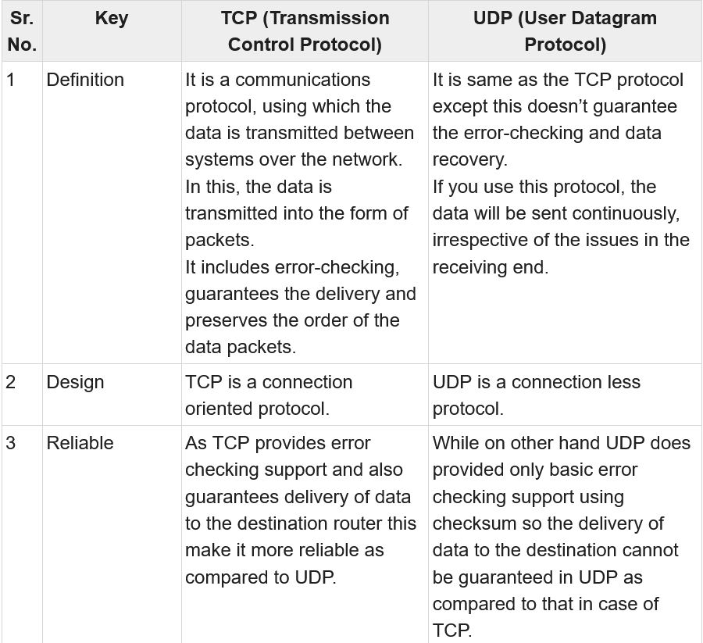
Difference :TCP&UDP

Slide 30
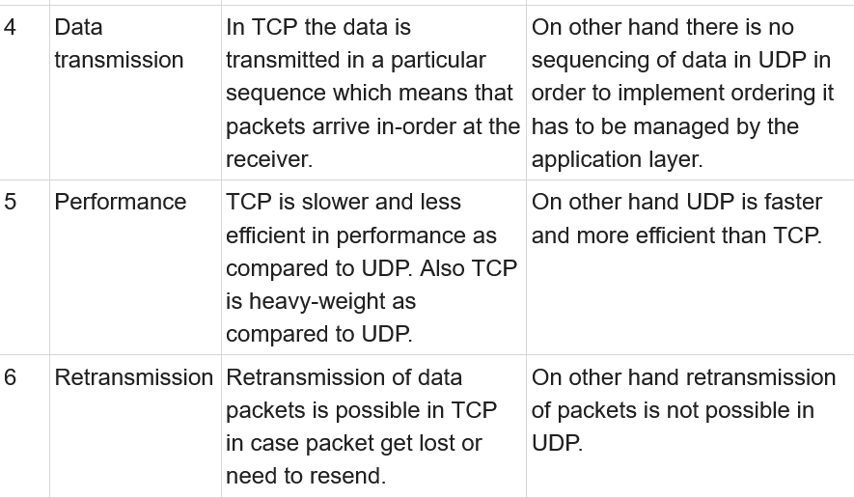
Difference :TCP&UDP

Slide 31
